Slide 1

Emotion Detection From Text or Sentiment Analysis using Python
By:- Vasu Goel
Reg No.:- 11907868
Roll No.:- RKM053A16

Slide 2


Slide 3

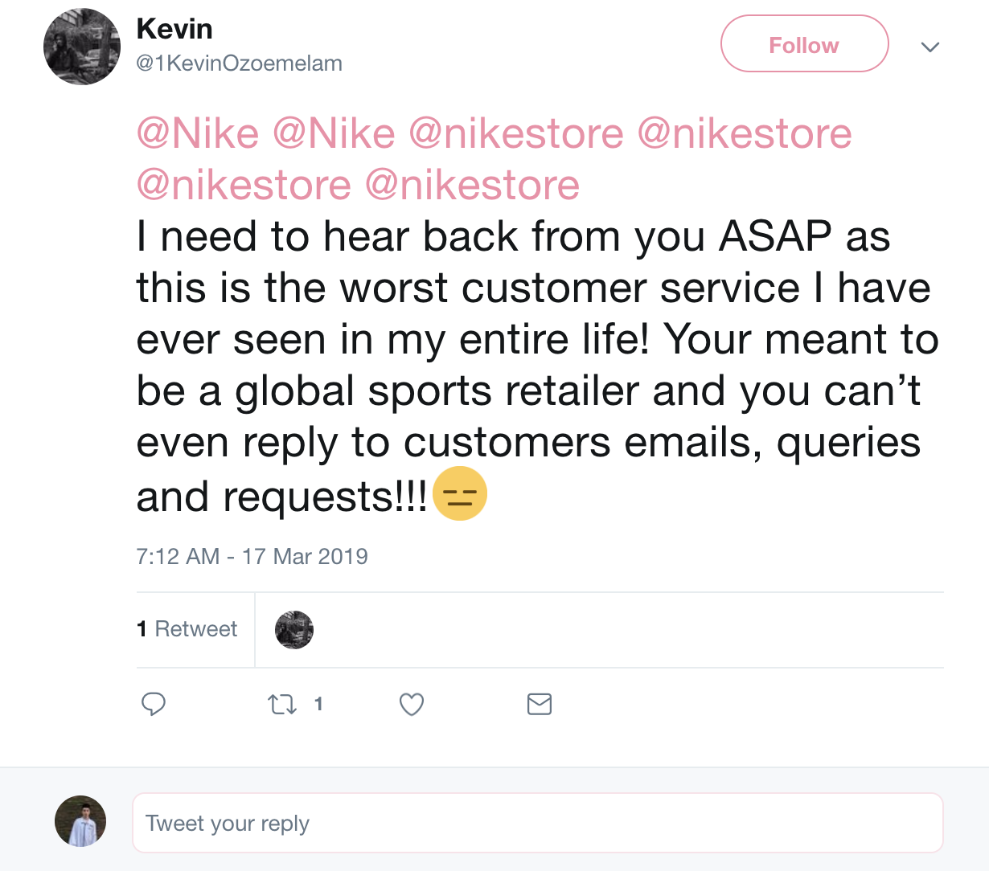

What is Sentiment Analysis

Slide 4
What is Sentiment Analysis
Process of Computationally identifying and categorizing opinions from piece of text, and determine whether the writer’s attitude towards particular topic or the product, is positive, negative or neutral.

Slide 5


Slide 6
Intuition – Data Cleaning
Original Reviews
Dropping Special Characters & #’s
Converting to small case
Dropping Stopwords and Stemming
Wow… Loved this place.
Crust is not good.
Not tasty and the texture was just nasty.
Also there are combos like a burger, fries and beer for 23 which is a decent deal.
I would definitely recommend the wings as well as the pizza.
Highly recommended.

Slide 7
Intuition – Data Cleaning
Original Reviews
Dropping Special Characters & #’s
Converting to small case
Dropping Stopwords and Stemming
Wow… Loved this place.
Crust is not good.
Not tasty and the texture was just nasty.
Also there are combos like a burger, fries, and beer for 23 which is a decent deal.
I would definitely recommend the wings as well as the pizza.
Highly recommended.

Slide 8
Intuition – Data Cleaning
Original Reviews
Dropping Special Characters & #’s
Converting to small case
Dropping Stopwords and Stemming
Wow Loved this place
Crust is not good
Not tasty and the texture was just nasty
Also there are combos like a burger fries and beer for which is a decent deal
I would definitely recommend the wings as well as the pizza
Highly recommended

Slide 9
Intuition – Data Cleaning
Original Reviews
Dropping Special Characters & #’s
Converting to small case
Dropping Stopwords and Stemming
Wow Loved this place
Crust is not good
Not tasty and the texture was just nasty
Also there are combos like a burger fries and beer for which is a decent deal
I would definitely recommend the wings as well as the pizza
Highly recommended

Slide 10
Intuition – Data Cleaning
Original Reviews
Dropping Special Characters & #’s
Converting to small case
Dropping Stopwords and Stemming
wow loved this place
crust is not good
not tasty and the texture was just nasty
also there are combos like a burger fries and beer for which is a decent deal
i would definitely recommend the wings as well as the pizza
highly recommended

Slide 11
Intuition – Data Cleaning
Original Reviews
Dropping Special Characters & #’s
Converting to small case
Dropping Stopwords and Stemming
wow loved this place
crust is not good
not tasty and the texture was just nasty
also there are combos like a burger fries and beer for which is a decent deal.
i would definitely recommend the wings as well as the pizza
highly recommended
Stop words
To-be-Stemmed words

Slide 12
Intuition – Data Cleaning
Original Reviews
Dropping Special Characters & #’s
Converting to small case
Dropping Stopwords and Stemming
wow love place
crust not good
not tasti textur nasti
Also combo like burger fri beer decent deal
would definit recommend wing well pizza
Highli recommend

Slide 13


